Slide 1
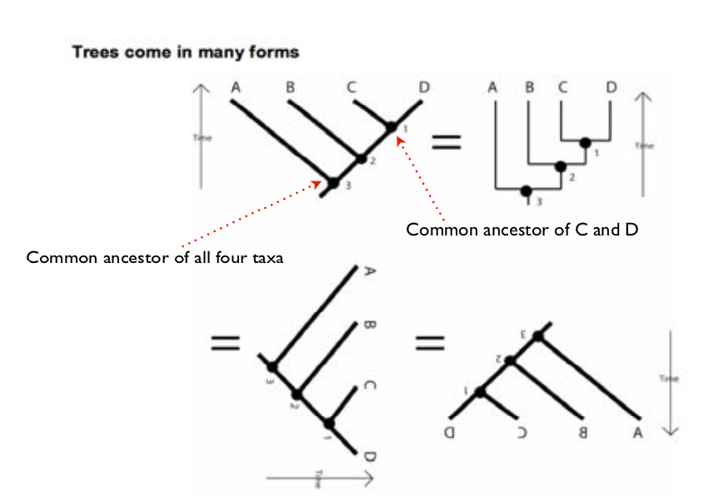

Slide 2
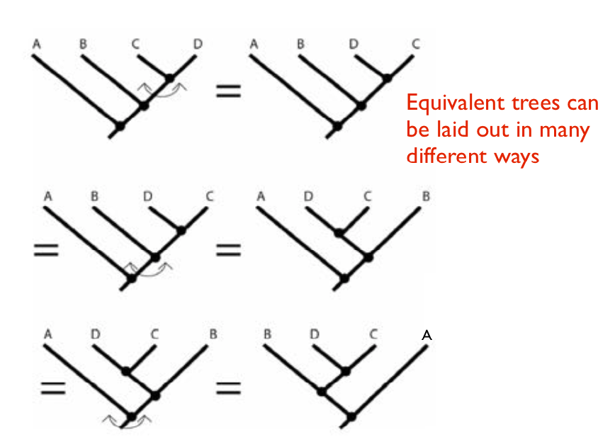

Slide 3
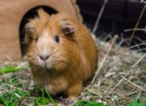
Evolutionarily Distinct: (kind of) New approach to conservation
$5
???
Notes:
EDGE: Evolutionarily Distinct and Globally Endangered
Handleys slender mouse opossum

Slide 4
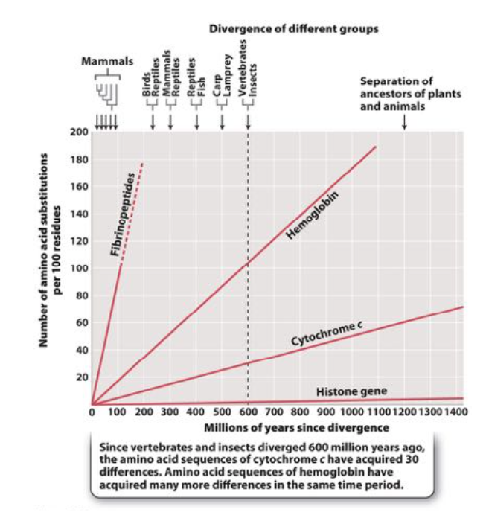

Slide 5
KEY TERMS:
Ancestral: original trait also known as PLEISIOMORPHIES
  SYNPLEISIOMORPHIES: shared ancestral characters
Derived: innovations also known as APOMORPHIES
  SYNAPOMORPHIES: shared derived characters

Slide 6
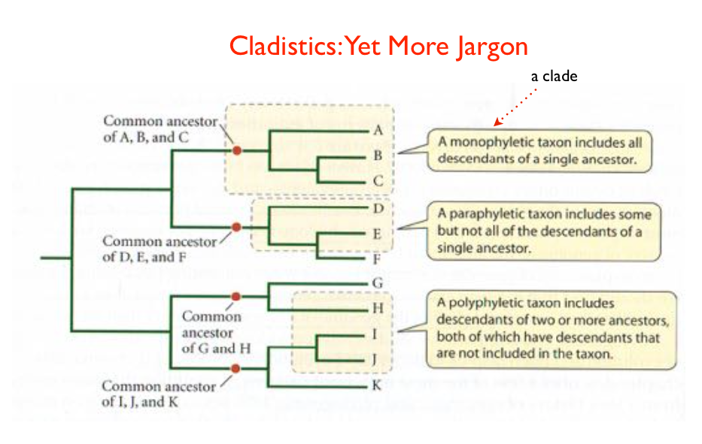

Slide 7
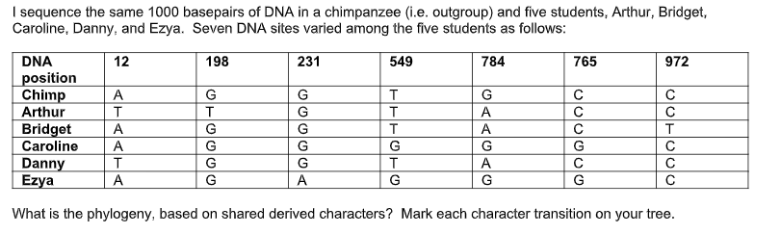

Slide 8
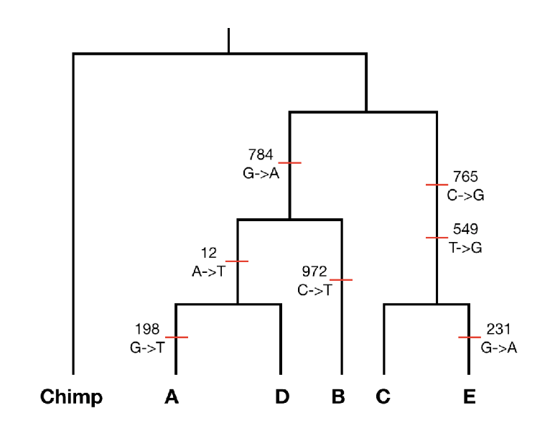

Slide 9
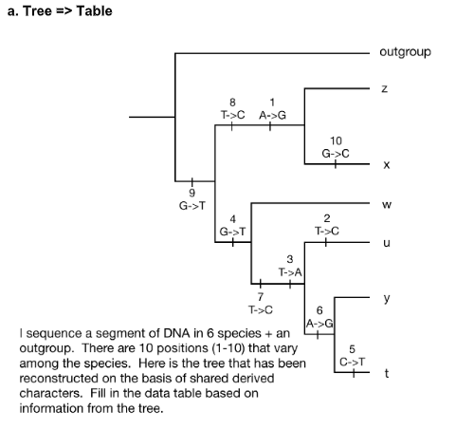

Slide 10
